Slide 1
Lecture 4: Modeling Mechanical Systems
determine the differential equations that model the behavior of a mechanical system
Elements making up a mechanical system
Modeling examples
Translational examples
Rotational examples

Slide 2
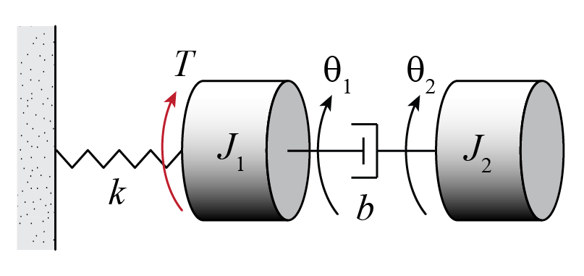
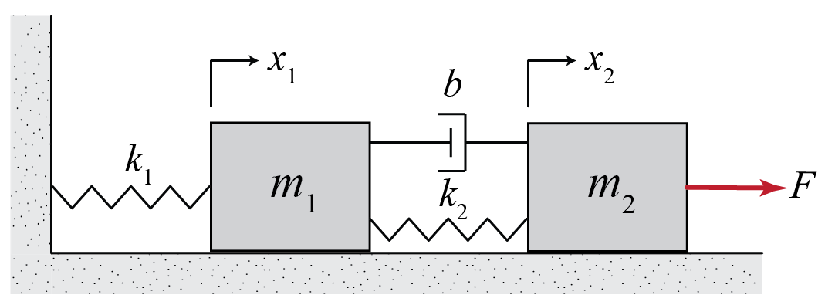
Modeling Mechanical Systems
Mechanical systems consist of three basic types of elements
Inertia elements
Spring elements
Damper elements
Notes:
So far we have been speaking about differential equation models and how to solve them with the Laplace transform … these diff eqs represent real physical systems and today we talk about that some
Things besides springs add stiffness and things besides dampers add damping

Slide 3
Inertia Elements
Examples: mass, moment of inertia
Each inertia element with independent motion needs its own differential equation (Newton’s 2nd Law, Euler’s 2nd law)
Inertia elements store kinetic energy

Slide 4
Spring Elements
Force (torque) is generated to resist deflection
Examples: translational and rotational springs, even a steel rod has stiffness
Spring elements store potential energy

Slide 5
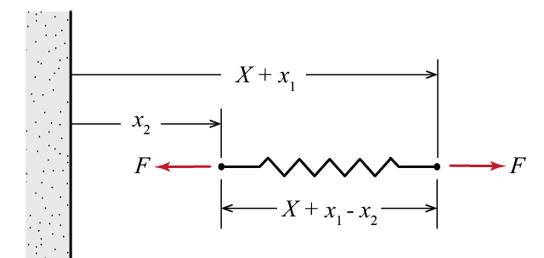
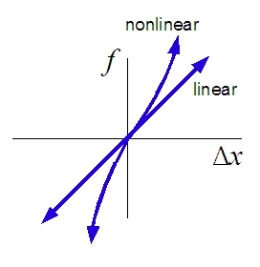
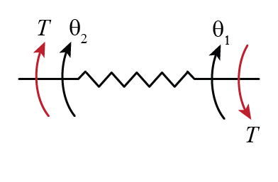
Spring Elements
For a linear translational spring:
For a linear torsional spring:
Notes:
All springs are really nonlinear, but for a small enough region, often a linear model is a good approximation
drive shaft … modulus of elasticity

Slide 6
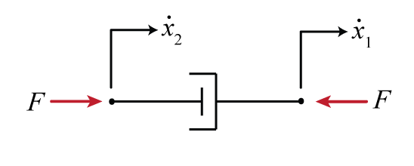
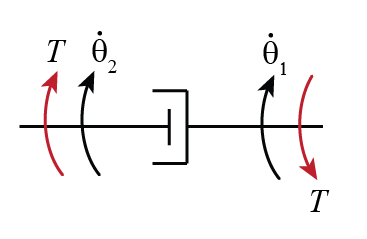
Damper Elements
Force is generated to resist motion
Examples: dashpots, friction, wind drag
Damper elements dissipate energy

Slide 7
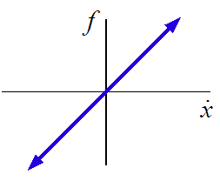
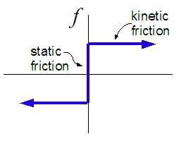
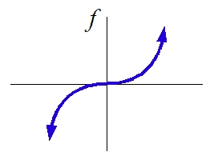
Damper Elements
linear damping
Coulomb friction
drag
(viscous friction)

Slide 8
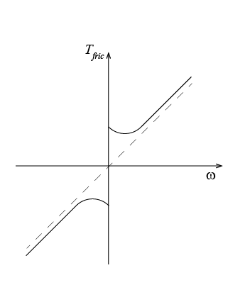
Friction Torque Example
Real friction in general combines aspects of multiple model types
viscous
friction
stiction
stiction

Slide 9
Modeling Mechanical Systems
Approach
Choose coordinates and orientation
Draw free-body diagrams for each inertia
Note assumptions
Generate equations of motion using Newton’s 2nd Law and Euler’s 2nd Law
Double check

Slide 10
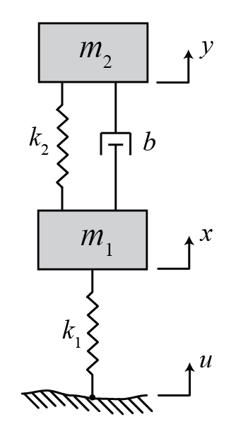
Example
Notes:
TRANSLATIONAL EXAMPLE (MULTI-BODY ¼ CAR SUSPENSION with damping) Ogata Figure 5-17
Mass spring damper systems are very common … useful because they are easy to visualize … will be useful even when we talk about circuits and motors
what everything represents … model tire has having stiffness and damping even though it isn’t a spring or dashpot
choose coordinates and orientation, state assumptions
SHOW WORK HERE … DO ON BOARD. JUST LEAVE SPACE FOR STUDENTS HERE.
Draw free body diagrams
Explain why gravity isn’t included
Sum forces
Double check (signs) … once you solve can get a better idea if this is reasonable

Slide 11
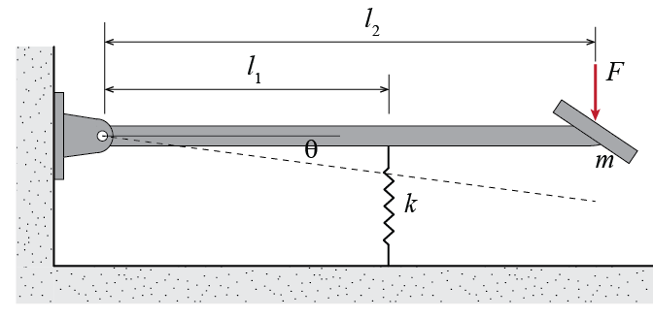
Example
→ assume linear spring, light rod
→ assume in static equilibrium at θ = 0
→ assume small deflection
Notes:
TRANSLATIONAL EXAMPLE (MULTI-BODY ¼ CAR SUSPENSION with damping) Ogata Figure 5-17
Mass spring damper systems are very common … useful because they are easy to visualize … will be useful even when we talk about circuits and motors
what everything represents … model tire has having stiffness and damping even though it isn’t a spring or dashpot
choose coordinates and orientation, state assumptions
SHOW WORK HERE … DO ON BOARD. JUST LEAVE SPACE FOR STUDENTS HERE.
Draw free body diagrams
Explain why gravity isn’t included
Sum forces
Double check (signs) … once you solve can get a better idea if this is reasonable

Slide 12
Example (continued)
Notes:
TRANSLATIONAL EXAMPLE (MULTI-BODY ¼ CAR SUSPENSION with damping) Ogata Figure 5-17
Mass spring damper systems are very common … useful because they are easy to visualize … will be useful even when we talk about circuits and motors
what everything represents … model tire has having stiffness and damping even though it isn’t a spring or dashpot
choose coordinates and orientation, state assumptions
SHOW WORK HERE … DO ON BOARD. JUST LEAVE SPACE FOR STUDENTS HERE.
Draw free body diagrams
Explain why gravity isn’t included
Sum forces
Double check (signs) … once you solve can get a better idea if this is reasonable

